Slide 1


Problem statement: Giggr Track Open Innovation (mobility)
Team name: The Down Trodence

Slide 2
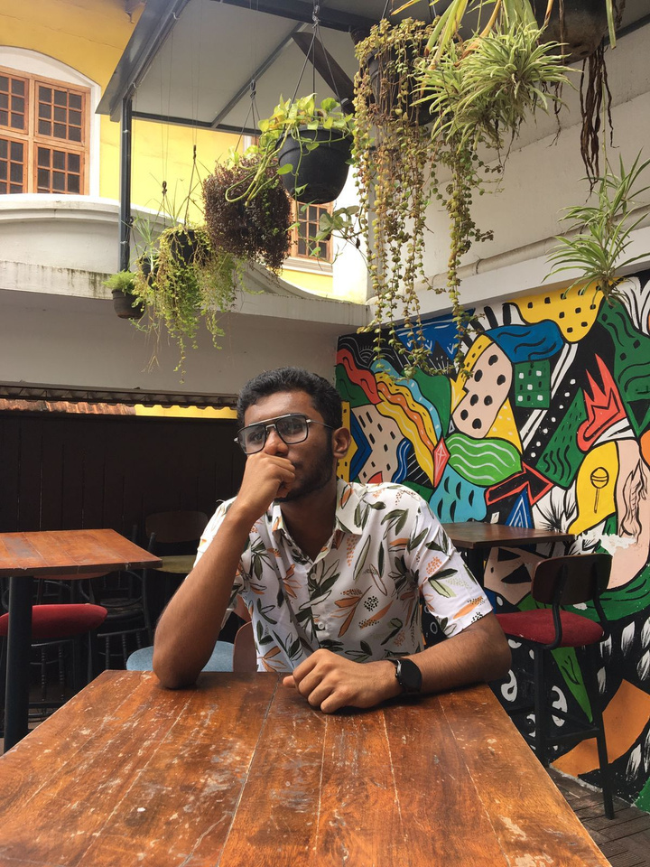
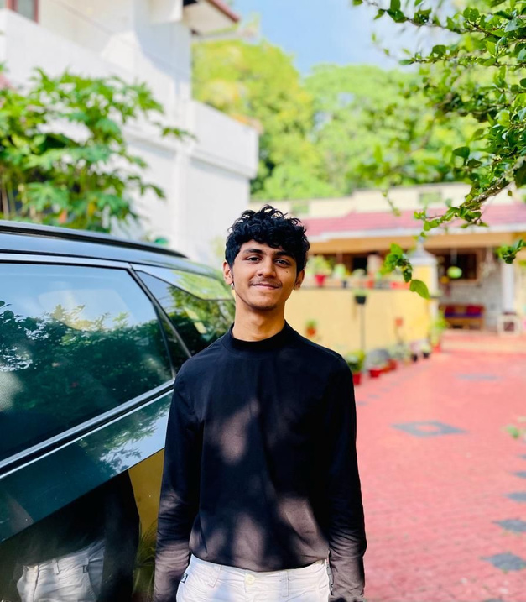
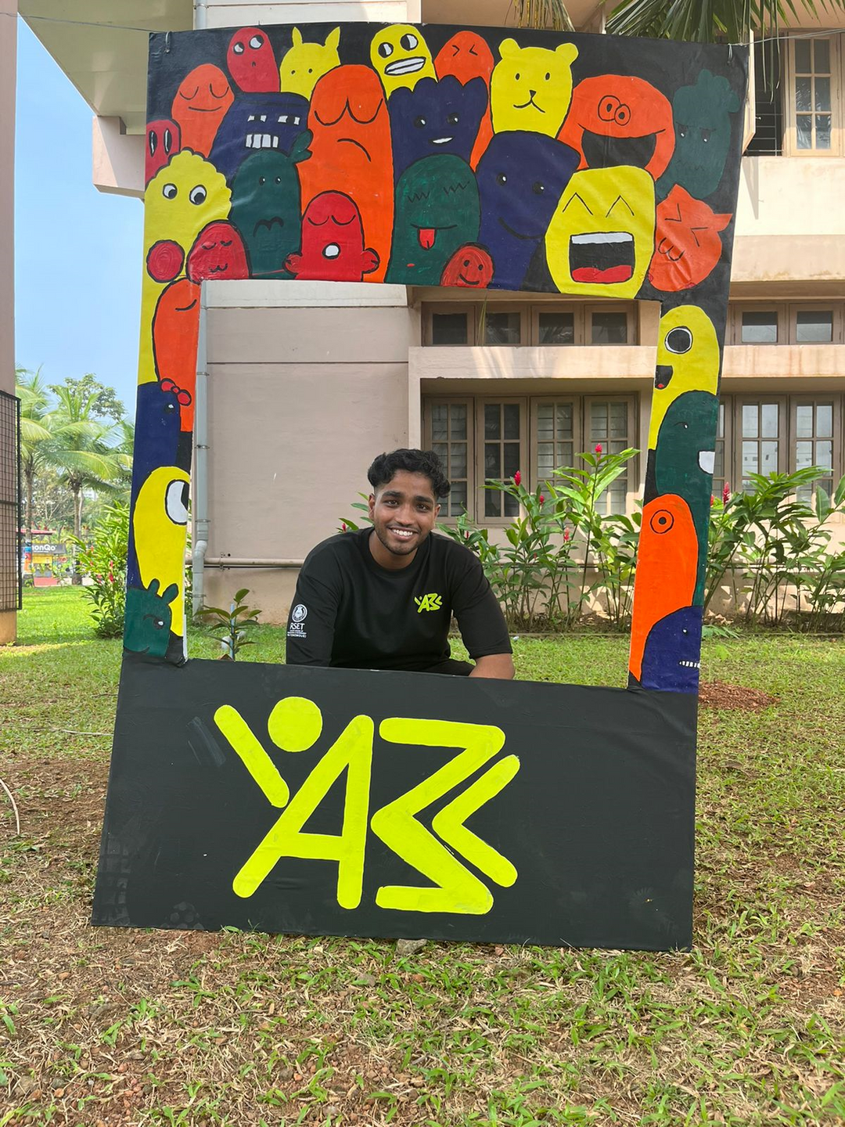
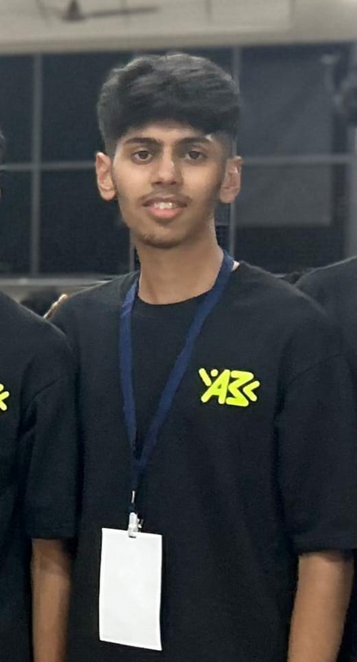
Team
Our team is called The Down Troddence and we consist of 4 team members, namely-
Adithya U- who studied in Rajagiri Public school, Kalamaserry. Stays in Thrikkakara.
Abhishikth S Mattom- who studied in K.E Carmel Central school, Muhamma. Stays in Cherthala, Alapuzha.
Antony Jose- who studied in St. Kuriakose Public school, Kaduthuruthy. Stays in Kaloor.
And Alen Abraham- who studied in Carmel Indian School, Kuwait. Stays in Thumpamon, Pathanamthitta.
Adithya
Abhishikth
Antony
Alen

Slide 3
THE IDEA
We aim to create a software application that will provide an easy interface for a sustainable, cost efficient and an easily accessible mode of transport.
The rates will be brought down far below to what is being charged right now and our application will be able to calculate the cost at the rate of 1rs per km.
The users themselves will be driving the cars thereby attracting the interest of driving
enthusiast.

Slide 4
small briefing : A car rental system in which the customer can drive the car. He can book any car from nearby hub station and pick up the car from there. After he drives he can bring the car back to any nearby hub station. The hub station includes charging and lounge facility.
business plan: Mainly targeted towards lower middle class people , we get revenue from the ads that are displayed in the lounge area through digital advertisement, books etc.
a problem we might face: initial cost, competition from fellow companies

Slide 5
Value Added
FUNCTIONAL VALUE
The application aims to provide help to those people who are interested in driving but cannot do so due to the lack of vehicles.The targeted customers being the lower midlle class who cannot afford expensive mode of transport.
ECONOMIC VALUE
The funding required for maintaining the cars and the pubs will be found through sponsorship and advertisements provided in the hubs.Through this way the clients acan be provided with a cost efficient mode of transportation.

Slide 6
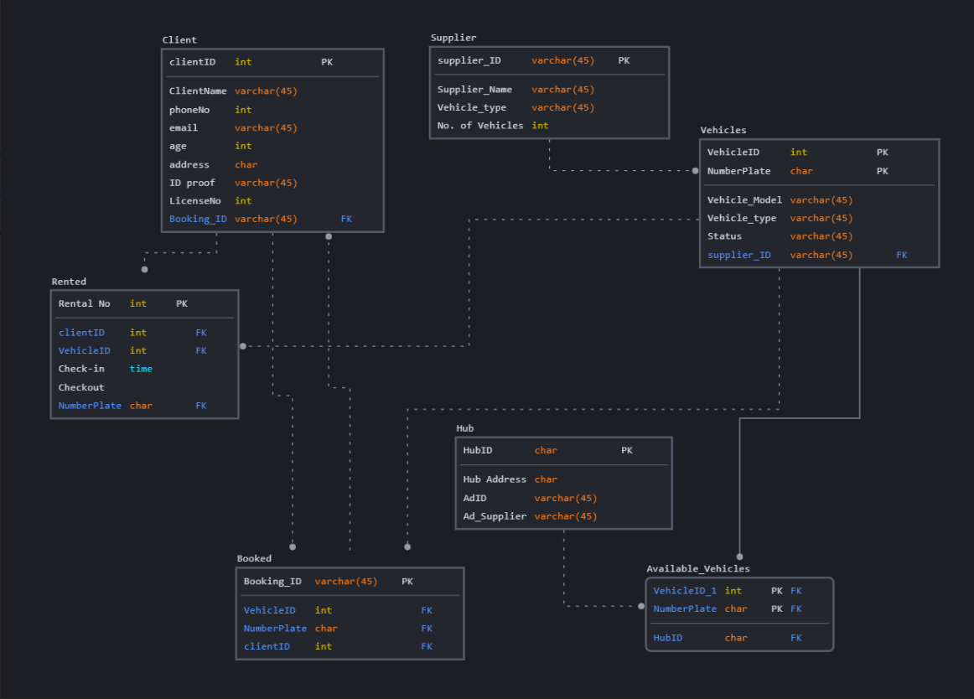
Prototype: Data Management

Slide 7
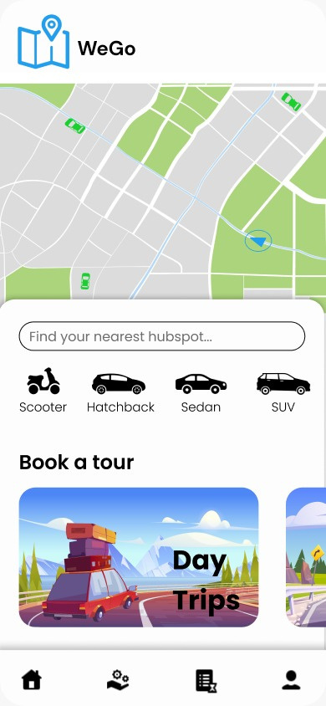
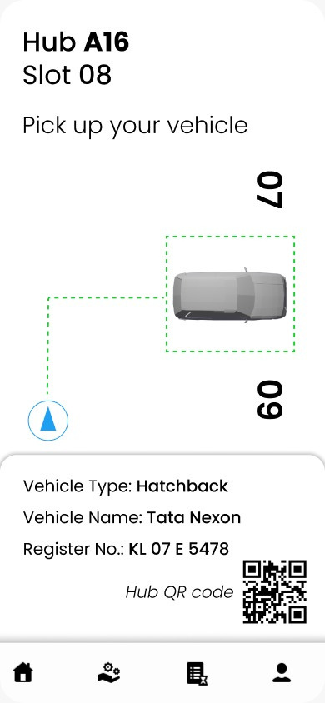
Opening of interface
Pickup page

